Slide 1
Chapter 7
Cost Concepts
And Management Needs

Slide 2
Cost Concepts For Control
(i) Responsibility Cost
(ii) Controllable and Non- Controllable Costs
(iii) Direct and Indirect Costs

Slide 3
(i) Responsibility costs
Responsibility costs are costs which are classified/identified /accumulated with the person(s) responsible for their incurrence.
(ii) Controllable and Non-controllable costs
(ii) Controllable and Non-controllable costs
An item of cost is controllable if the amount of cost incurred in (assigned to) a responsibility centre is significantly influenced by the actions of the manager of the responsibility centre. Otherwise, it is non-controllable.
(ii) Direct and indirect costs
Those costs which can be identified logically and practically in their entirety to a particular department/product are called direct costs. Those costs which are not practically identifiable exclusively and wholly to a particular product/division/segment are called indirect (common) costs.

Slide 4
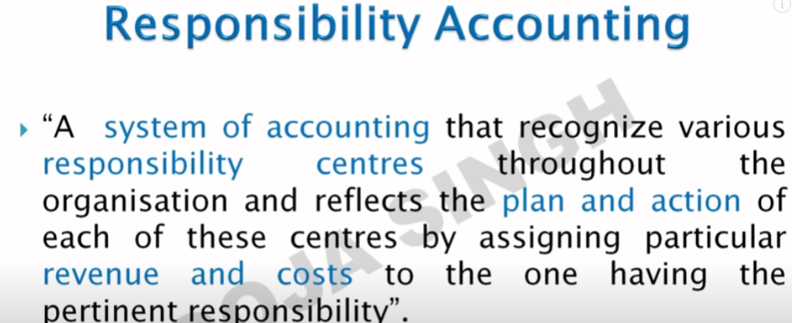

Slide 5
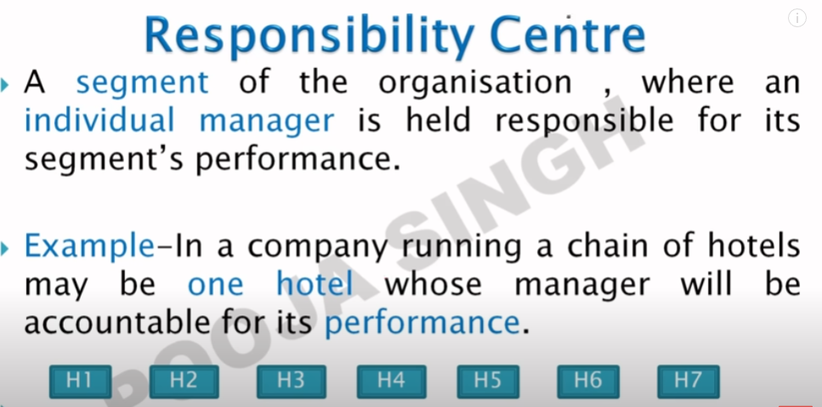
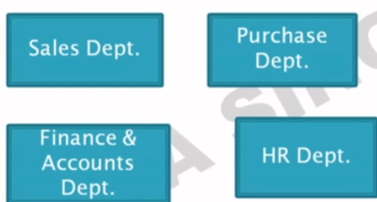

Slide 6
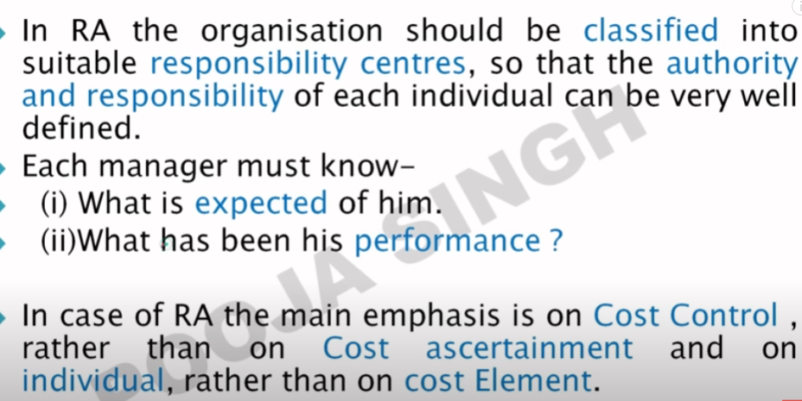

Slide 7
Type of responsibility center
Cost center
Revenue center
profit center
Investment centre

Slide 8
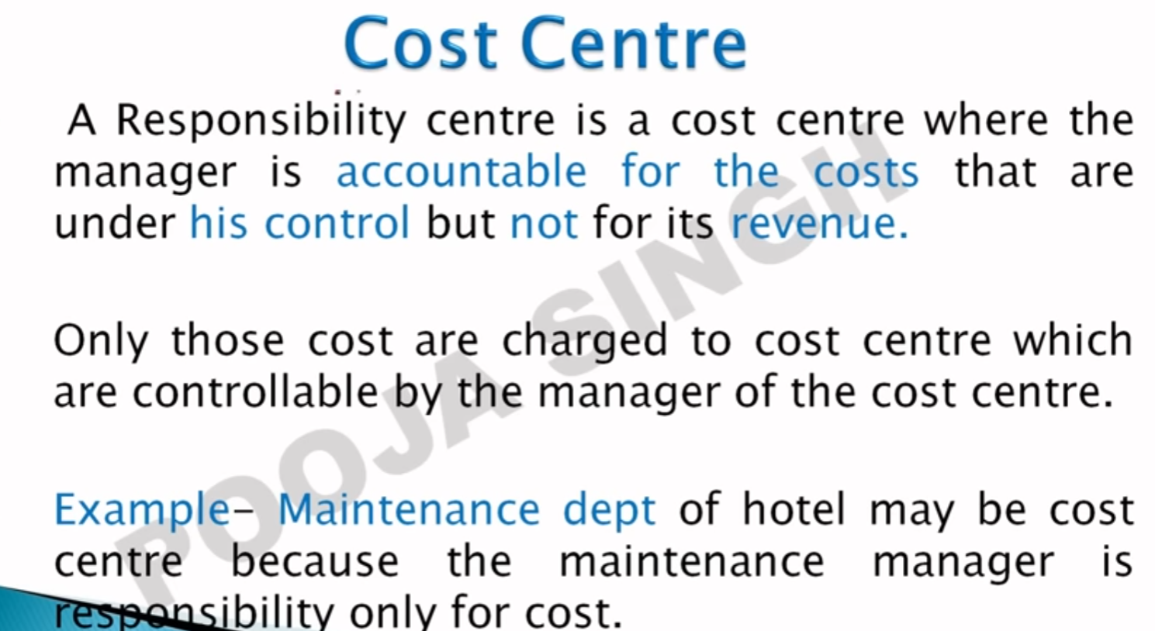
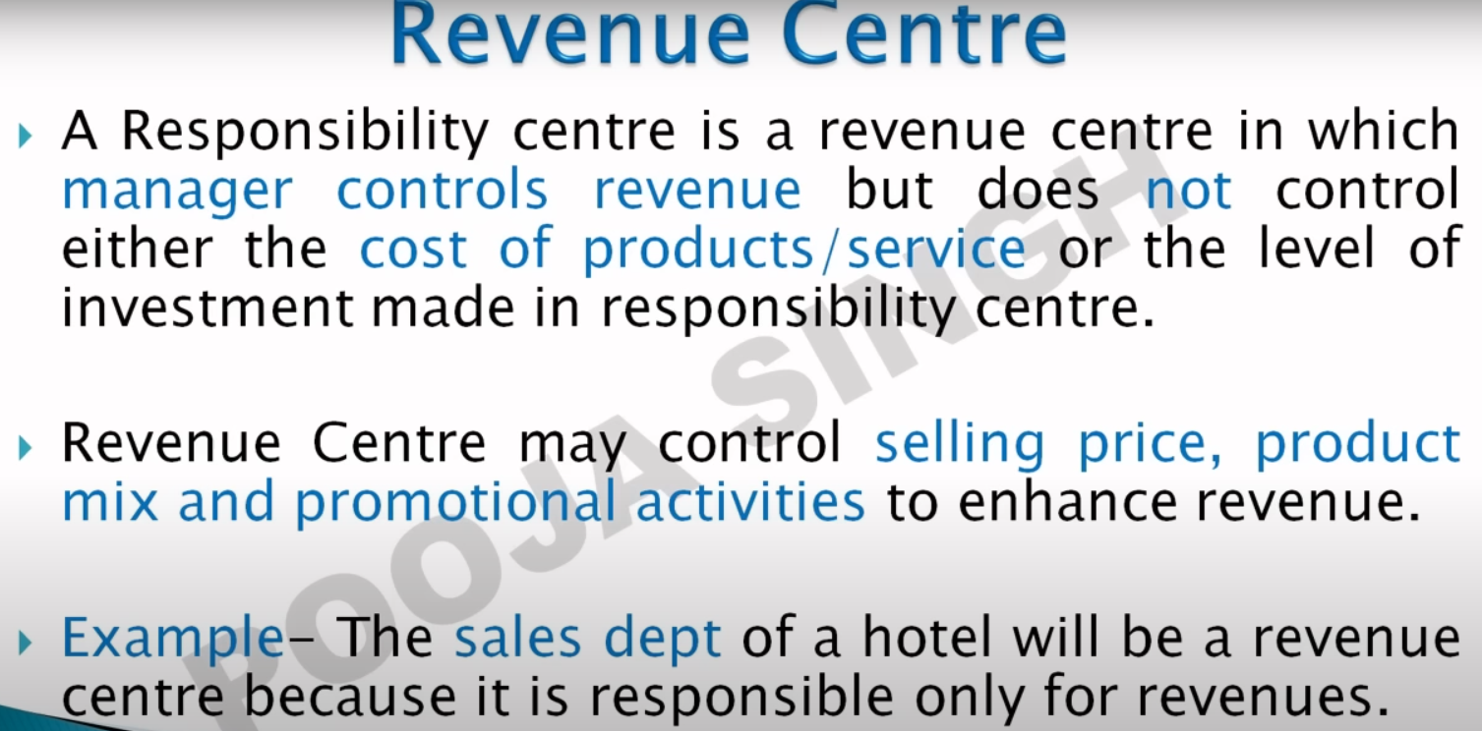
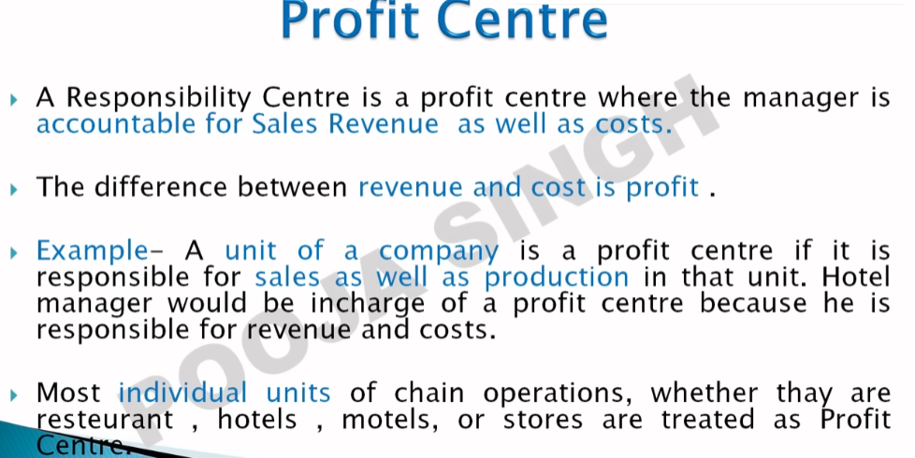
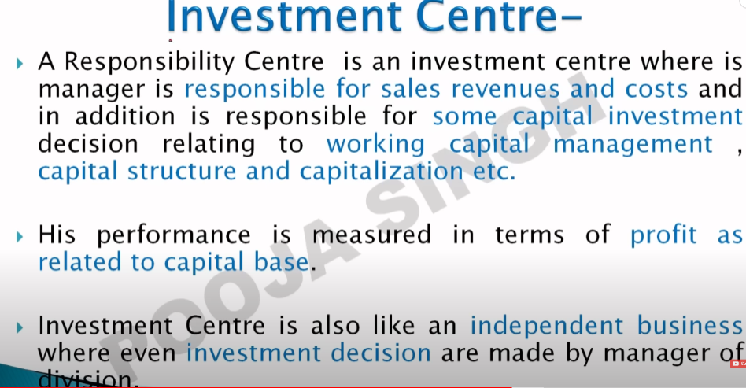

Slide 9
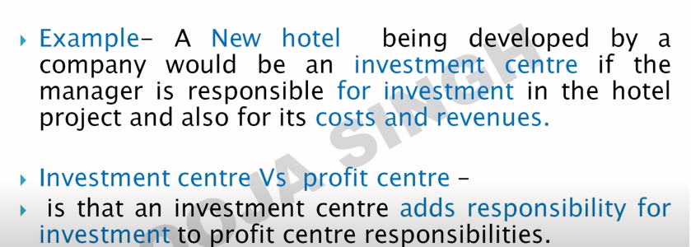

Slide 10
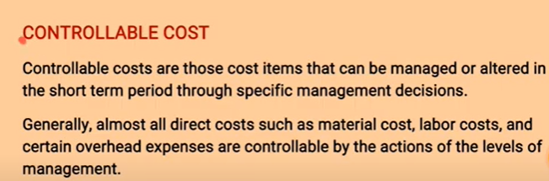
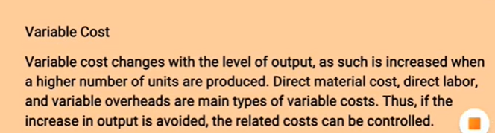
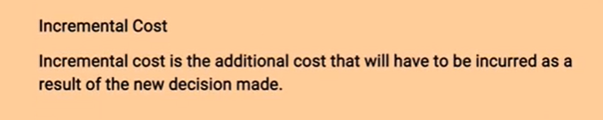

Slide 11

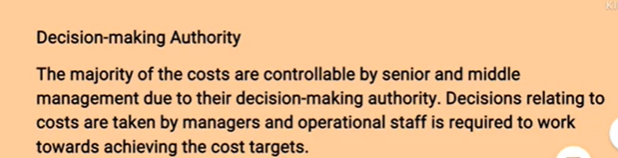

Slide 12
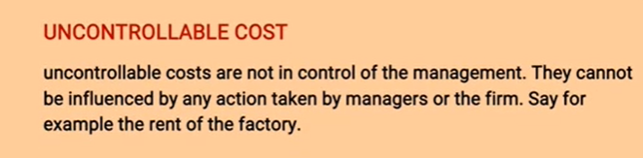
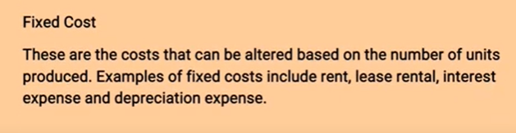
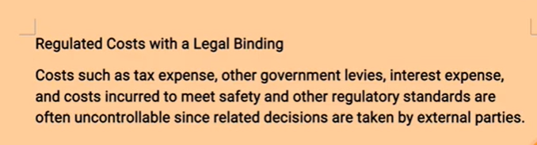

Slide 13
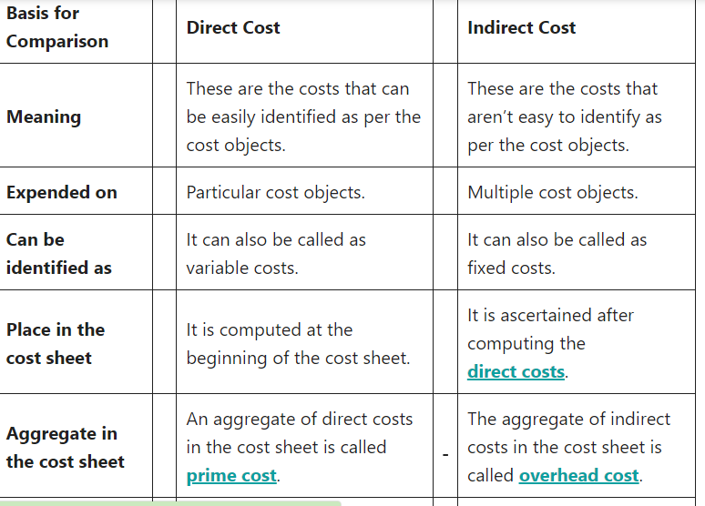

Slide 14
Cost Concepts For Decision- Making
Relevant and Irrelevant Costs
Differential Costs
Out-of-pocket Costs and Sunk Costs
Opportunity Costs and Imputed Costs

Slide 15
Relevant and Irrelevant costs
Costs which are influenced by a decision are a relevant cost and cost which is not affected by a decision is irrelevant cost.
Differential costs
Differential/incremental costs are the differential/additional costs which would be incurred if the management chooses one course of action as opposed to another. They are differential/incremental costs caused by a particular decision.

Slide 16
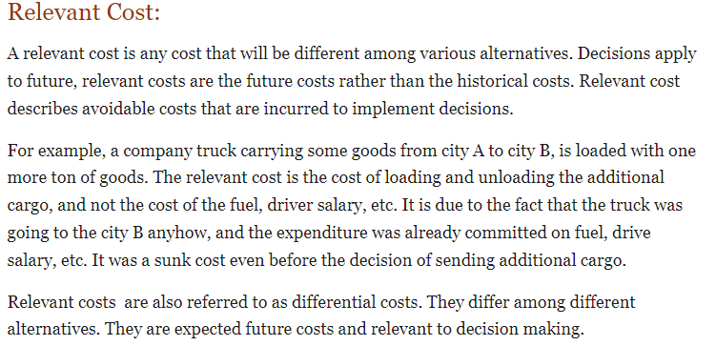

Slide 17
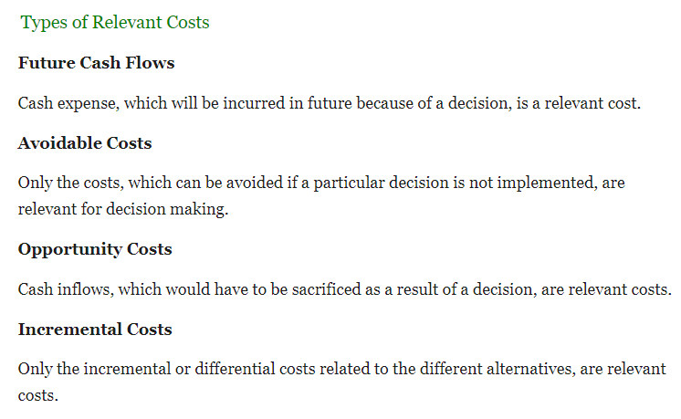

Slide 18
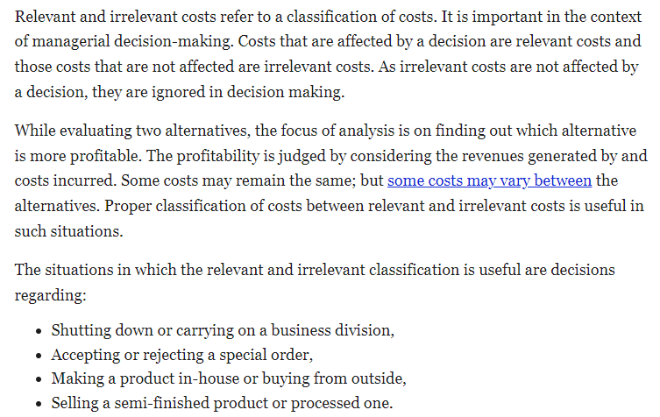

Slide 19
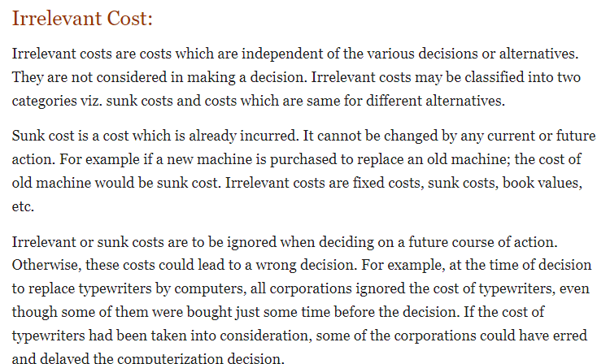

Slide 20
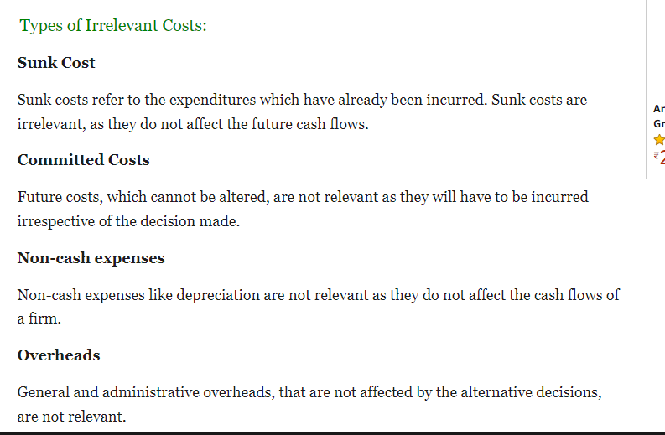

Slide 21
Out-of-pocket costs and Sunk costs
A cost which requires a current/future cash expenditure as a result of a decision is an out of pocket cost. Costs which have already been incurred in the past are sunk costs.
Opportunity costs and Imputed costs
Opportunity cost represents the benefits foregone by not choosing the second best alternative in favour of the best one. Imputed costs are hypothetical costs that must be considered for correct decision, for example, interest cost.

